Slide 1

IT SUPPORT & DEVELOPMENT TRAINING PROGRAMME
Corporate Skills
Unit: 1
Professional Manners and Etiquettes

Slide 2
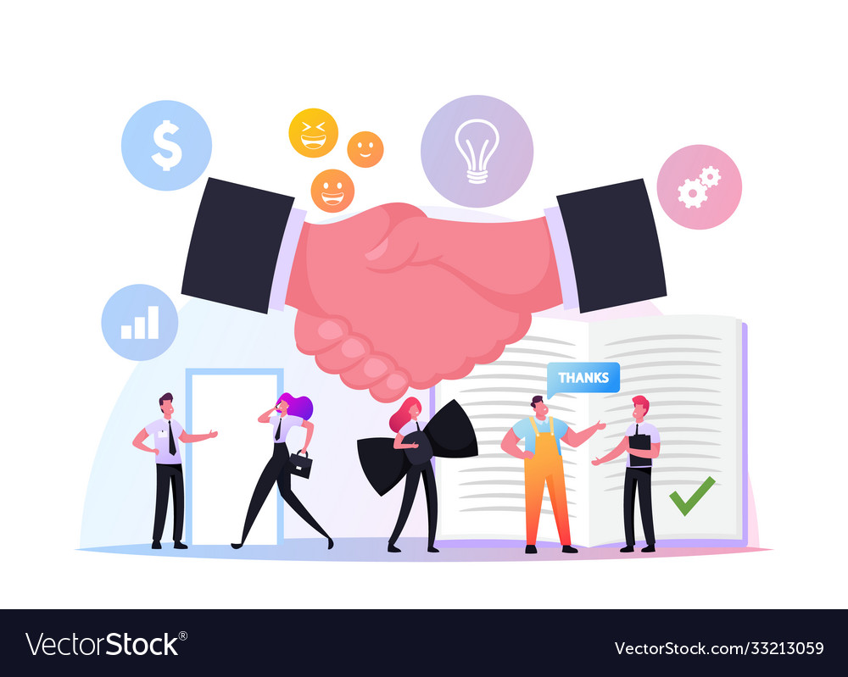
Professional Etiquette helps to behave in a socially responsible way and it helps you gain respect, trust and appreciation from others.

